Slide 1

Lecture #1

Slide 2
Computer Graphics
Computer Graphics involves technology to accept, process, transform and present information in a visual form that also concerns with producing images (or animations) using a computer.
“In general we can say that computer graphics is all about computer generated images and animations.”

Slide 3
Why Study Computer Graphics?
1. VisualizationComputer graphics help us see things clearly.
For example, engineers, doctors, or scientists can use graphics to visualize data, models, or designs.It also allows us to share ideas visually with others instead of only using text or numbers.
2. Graphics is Interesting It’s not just about making pictures—it involves mathematics, simulation, algorithms, and computer architecture. This makes it both challenging and exciting to learn.
3. Requirement Graphics are not optional anymore—companies like Intel, NVIDIA, and AMD build powerful processors mainly because modern applications need graphics. Almost every field (games, education, medicine, design, AI) requires computer graphics.
4. Entertainment Movies, animations, and video games all depend on graphics. Without computer graphics, there would be no modern entertainment industry.
Notes:
Simulation:the production of a computer model of something, especially for the purpose of study

Slide 4
Ingredients of Computer Graphics
Graphic Application: is designed to produce graphics – visual representation in the form of pictures, slides etc
The User: The user runs the application, direct its sequence of action to accomplish some specific task
Display devices: Presents the text and picture to user Classified as hardcopy(printer, pen plotter etc.) and softcopy(CRT displays)
Host Computer: The host computer is a processor on which the application runs

Slide 5
Some History

Slide 6
History
The term “computer graphics” was coined in 1960 by William Fetter to describe new design methods that he was developing at Boeing.
He created a series of widely reproduced images on a plotter exploring cockpit design using a 3D model of a human body

Slide 7
Graphics Applications
User Interfaces
Layout and Design
Scientific Visualization and Analysis
Art and Design
Medicine and Virtual Surgery
Layout Design & Architectural Simulations
History and cultural heritage
Entertainment
Simulations(A simulation is an approximate imitation of the operation of a process or system; that represents its operation over time.)
Games

Slide 8
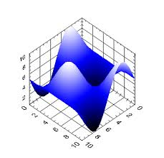
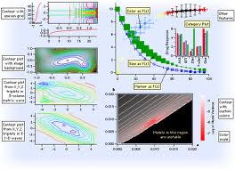
Graphs and Charts
Graphs are used to summarize financial, mathematical, scientific, engineering and economic data

Slide 9
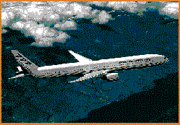
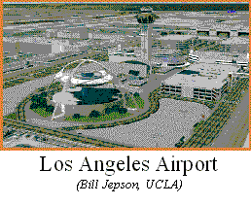
Computer aided design
Graphic software are used for design purposes
Applications are used to design automobiles and aircrafts Computer Aided Manufacturing (CAM)
Also used for architectural designs

Slide 10
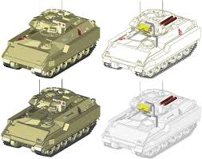
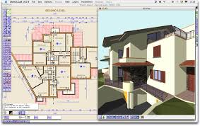
Computer Aided Design

Slide 11
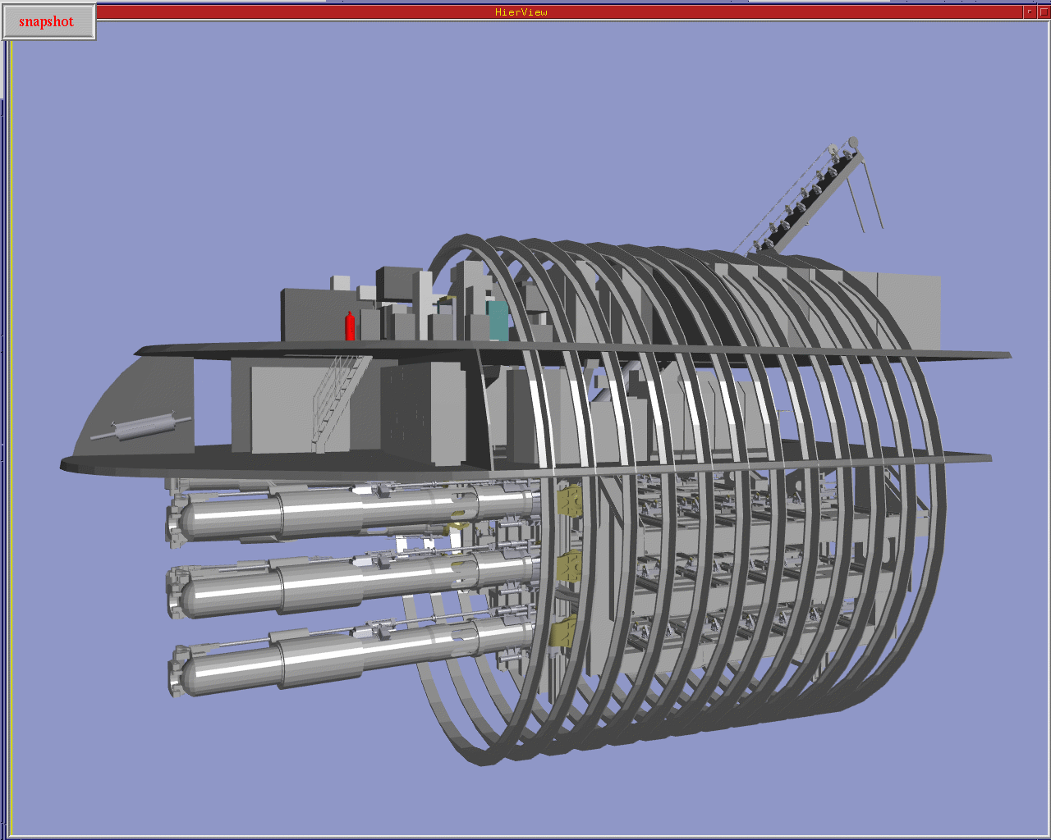
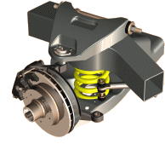
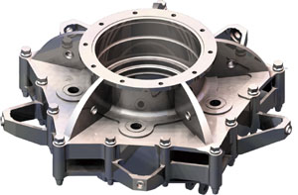
Computer Aided Manufacturing

Slide 12
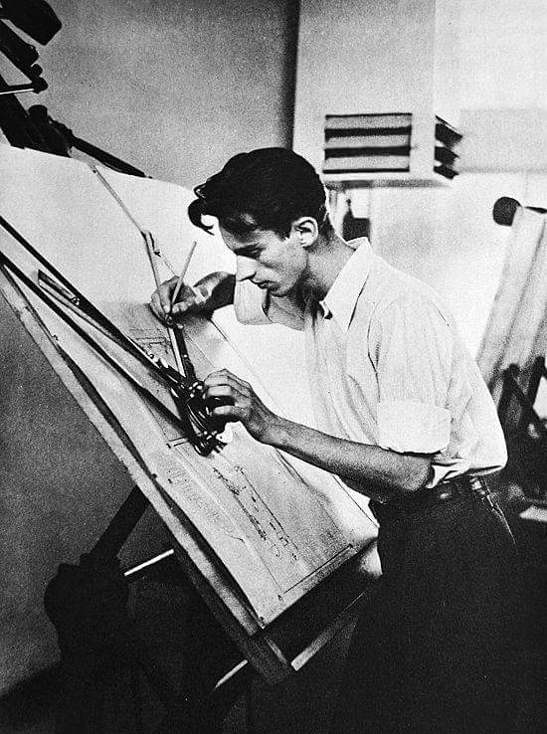

Slide 13
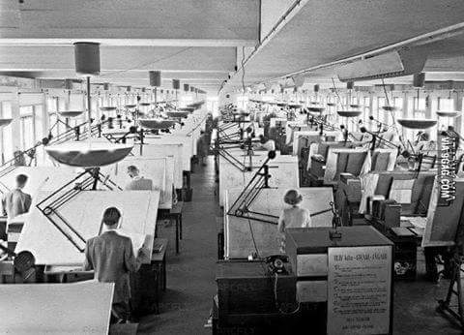

Slide 14
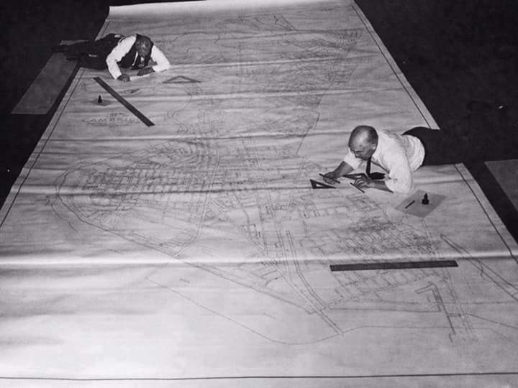

Slide 15
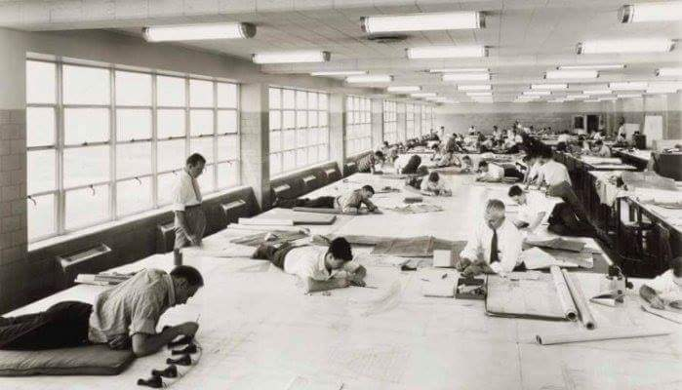

Slide 16
Graphics Hardware and Software
Input hardware
Touch panel
Light pen
Graphics Tablet
Plotter
Film recorder
Mouse
Joy stick
Your are already learn about input devices in previous semesters.
So here we discus Output devices.
Output devices
CRT(cathode Ray tube)
Vector scan display
Random scan display
Raster scan
Color monitors(LCD)

Slide 17
Graphics Software
Photoshop (for edit images)
Corel draw( for designing)
Adobe Illustrator is a vector graphics editor

